Slide 1
Create your account
Welcome to
Username
Enter a username
Locale
Email
Enter your email address
Built for citizens, by citizens.
Password
Enter a password
Confirm your password
✓
By signing up, you agree to the terms & conditions
Sign Up
Sign In
Aaron W.
Albert M.

Slide 2
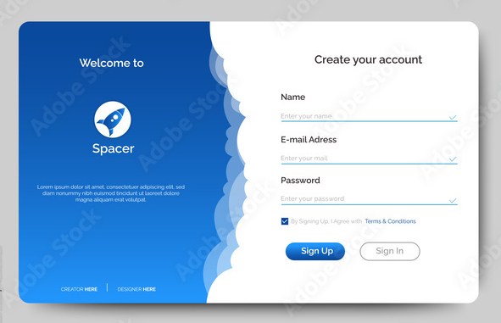








Inspiration for the login screen
Input verification
Welcome text
Sign up and sign in buttons
Names of creators

Slide 3
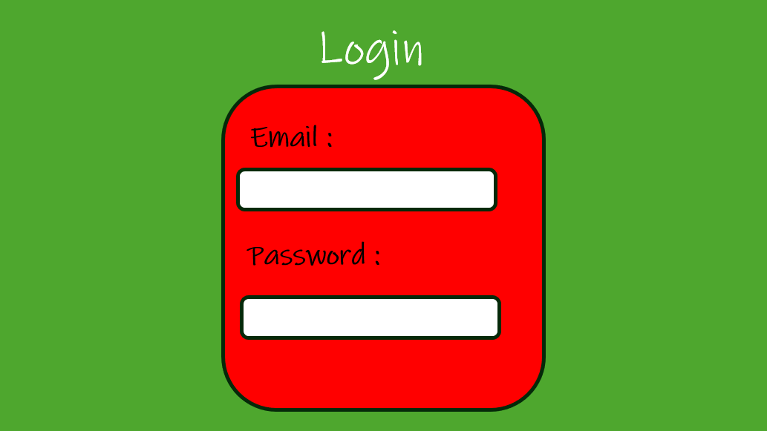
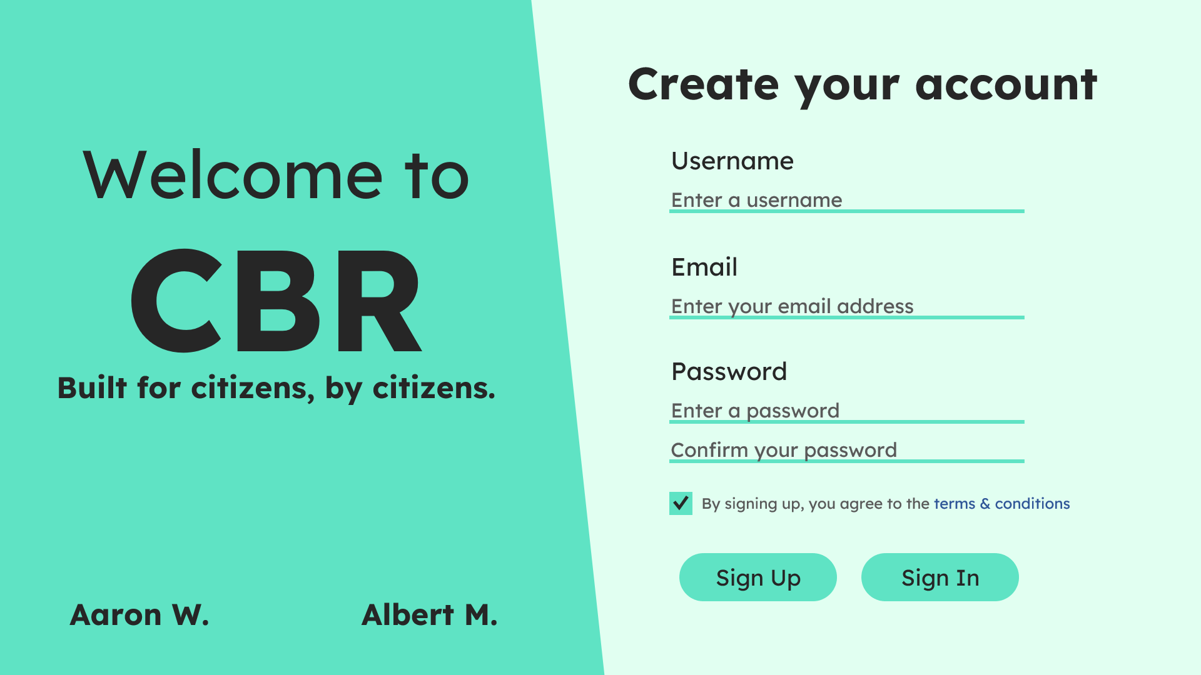
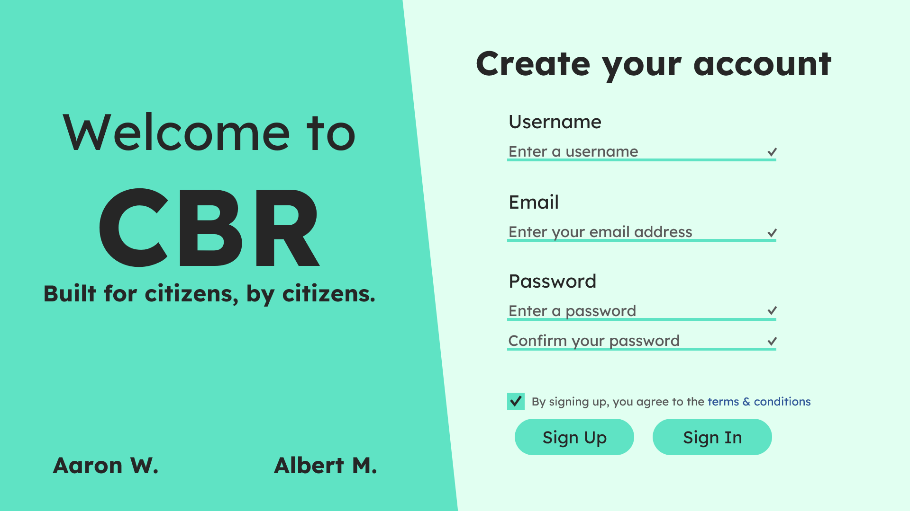
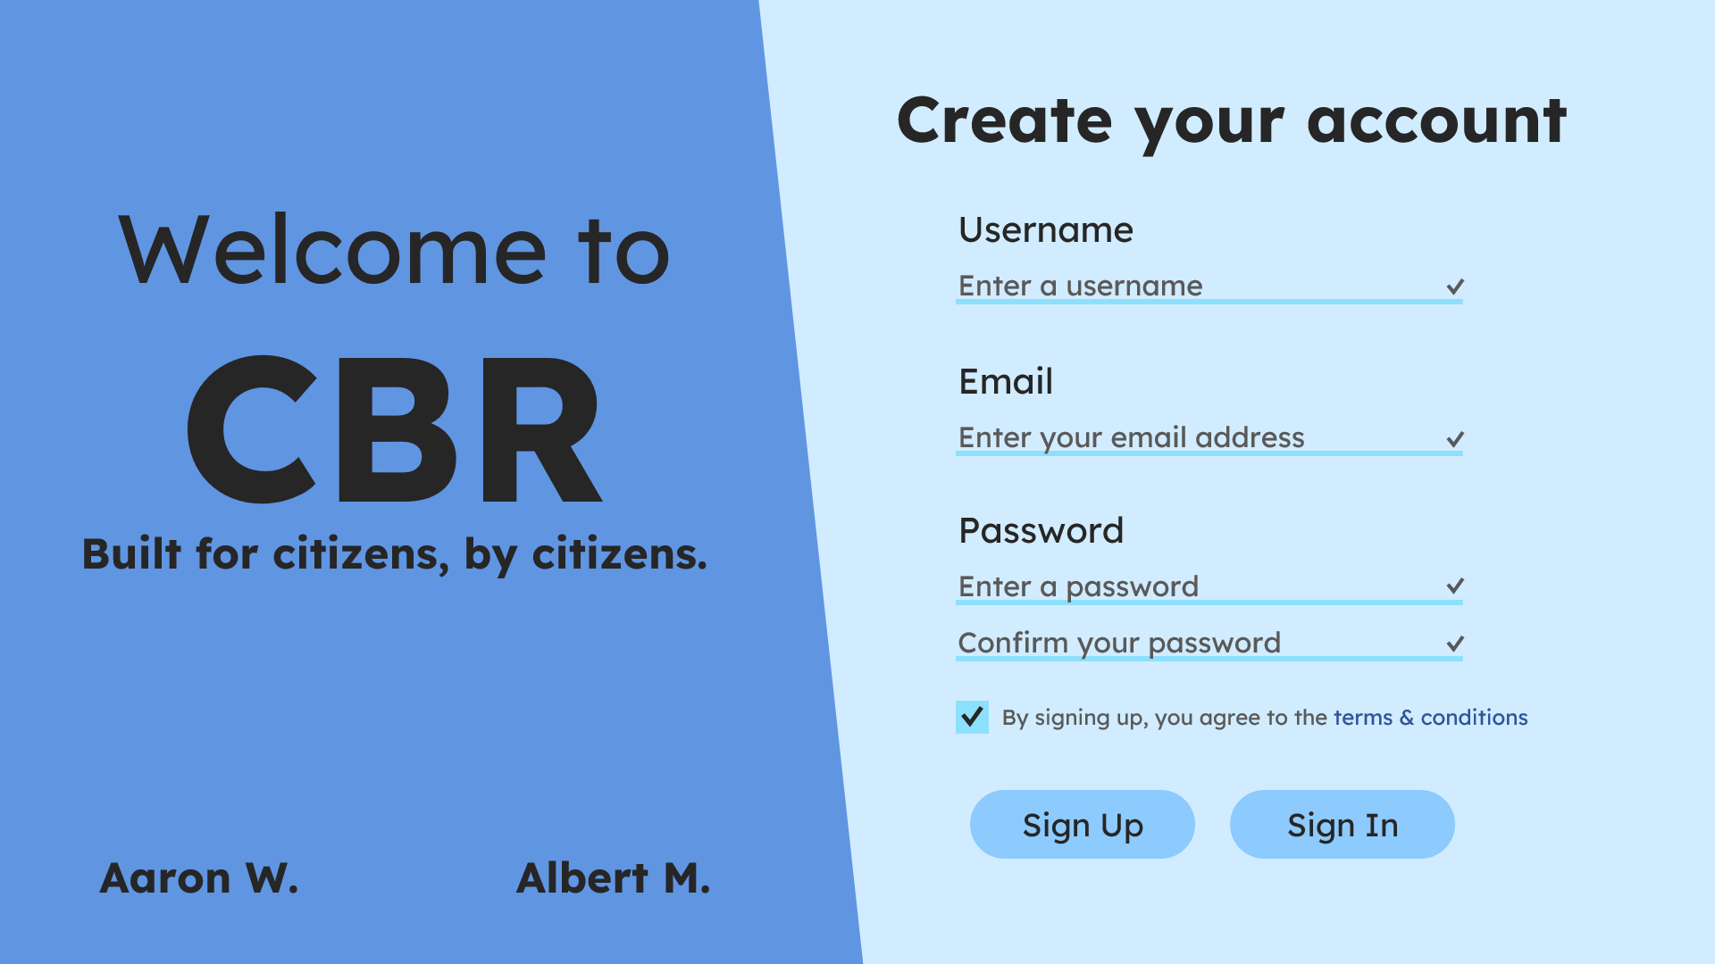
Design Evolution
Random design
First draft
Second draft
Most recent revision

Slide 4

Locale
Log in
Sign up
Built for citizens,
by citizens.
A free-forever platform to give your neighbors a heads-up when they need one most.
Enter your email address
Get started

Slide 5
Inspiration for the login screen
Input verification
Welcome text
Sign up and sign in buttons
Names of creators

Slide 6
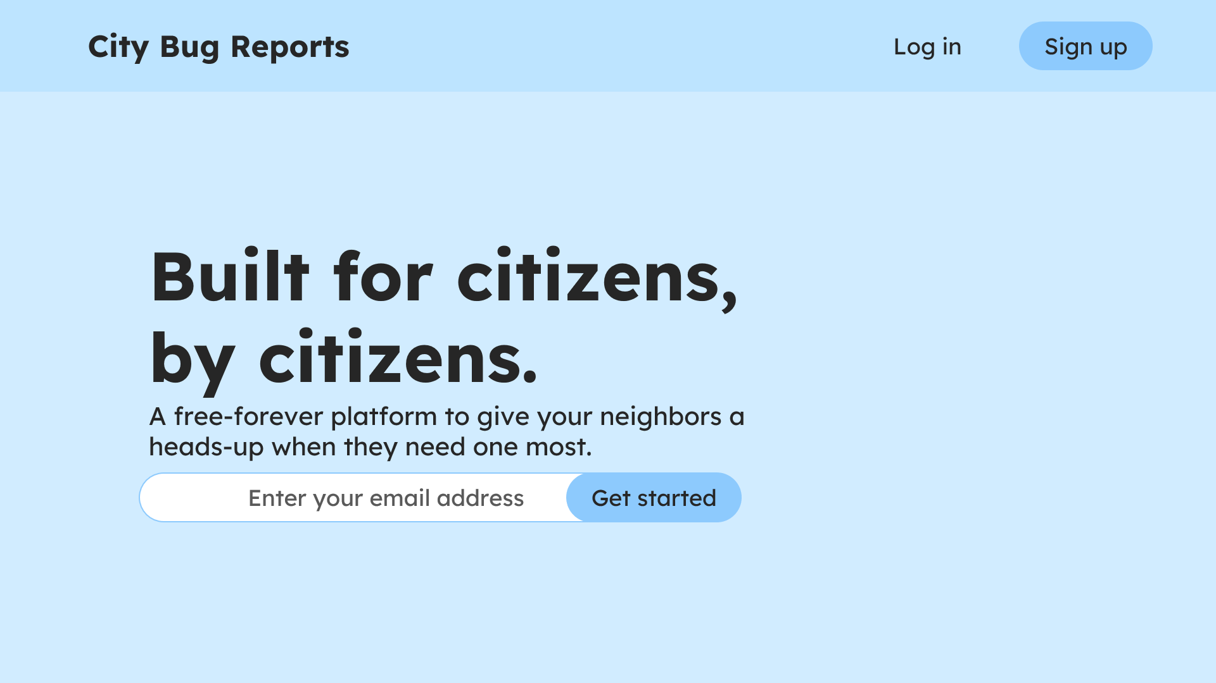
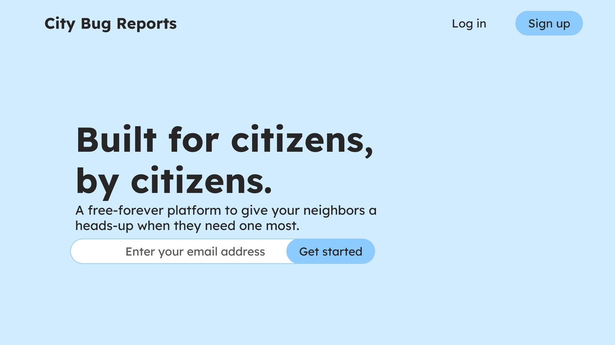
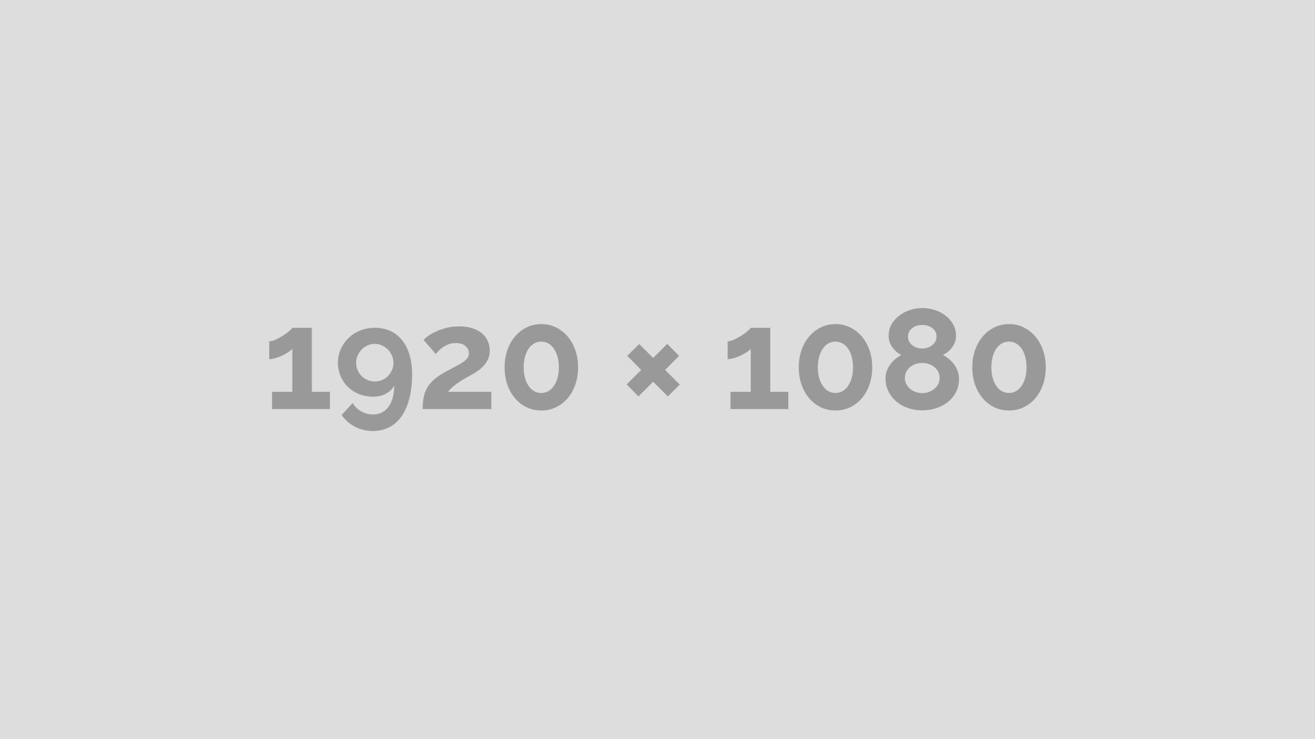
Design Evolution
First Draft
Second draft
Second draft
Most recent revision

Slide 7
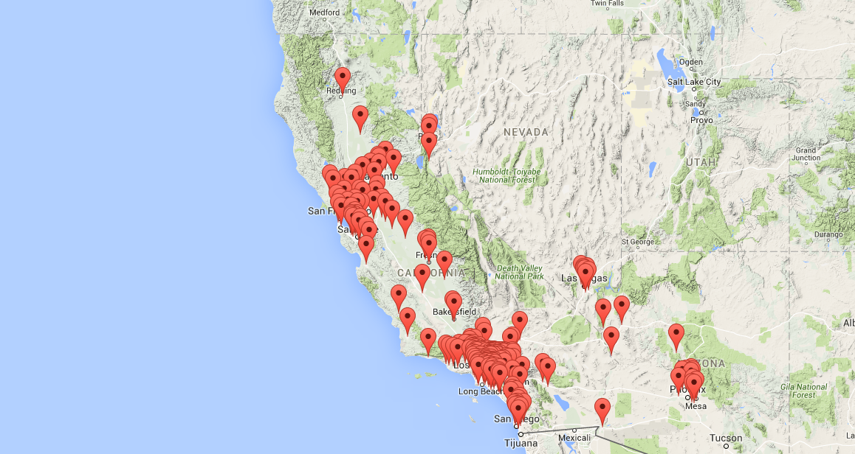
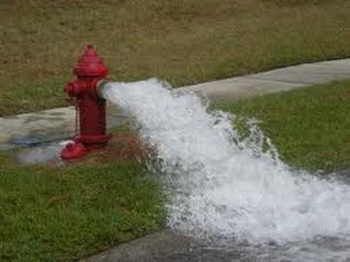

Locale
Dashboard
My cock and balls
1234 West 27th Avenue
Status: 8 inches
Watch out for: cum everywhere
Risk

Slide 8
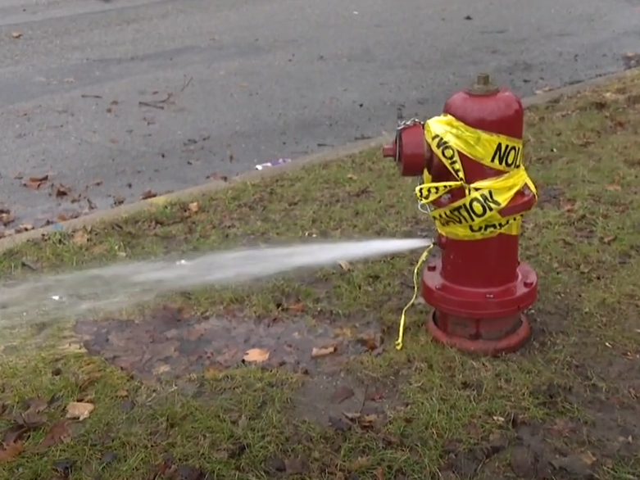
Locale
Dashboard
Broken Fire Hydrant
1234 West 27th Avenue
Status: Active
Watch out for: water, flooding
Risk

Slide 9
Locale
Dashboard
Report an issue
What should we watch out for?
describe the issue in a few words
How would you rate this issue?
Upload an image:
Upload

Slide 10
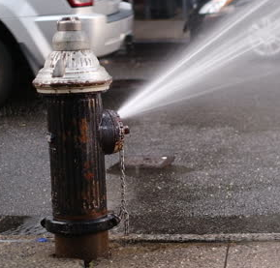

Locale
Resident Dashboard
Broken firehose
Located @49 Knight Street
….read more
Broken firehose
Located @49 Knight Street
….read more
Describe the issue
David Thompson Secondary School is on fire!
Womp
Submit issue

Slide 11





Locale
Moderator dashboard
Latest Issues
Broken firehose
49 Knight Street
….read more
Pothole
49 Knight Street
….read more

Slide 12
Locale

